Slide 1
Power BI Embedded
FSI CSU SWARM

Slide 2
Manage Capacity in Azure

Slide 3
Abstract and learning objectives
Learn how to Manage Capacities in Azure

Slide 4
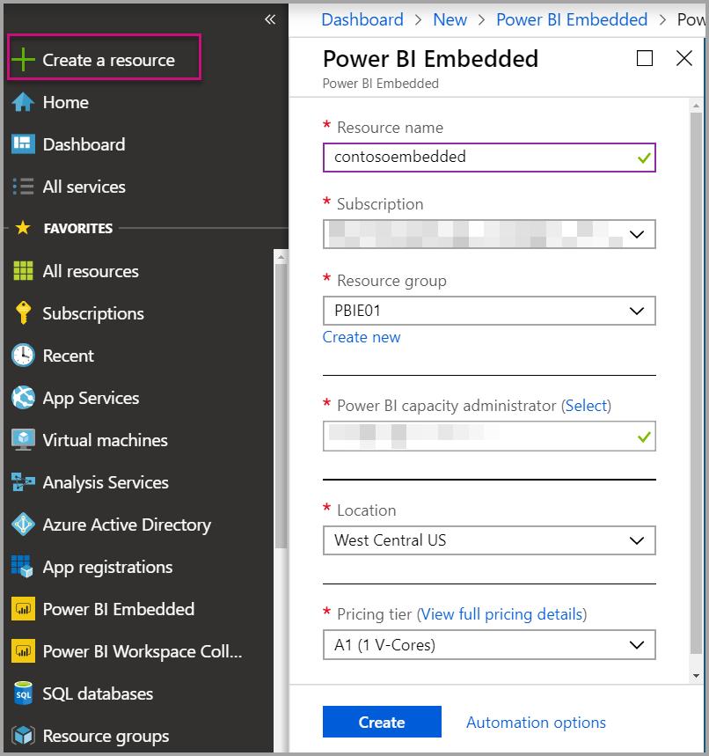
Create Capacity
Sign into the Azure portal.
Select, “Create a resource” and then, in the search box, search for Power BI Embedded.
Within Power BI Embedded, select Create.
Fill in the required information (see next slide for assistance) and then select Create.

Slide 5
Setting Options
Setting | Description
Resource name | A name to identify the capacity. The resource name is displayed within the Power BI admin portal in addition to the Azure portal.
Subscription | The subscription you would like to create the capacity against.
Resource group | The resource group that contains this new capacity. Pick from an existing resource group, or create another. For more information, see Azure Resource Manager overview.
Power BI capacity administrator | Power BI capacity administrators can view the capacity in the Power BI admin portal and give assignment permissions to other users. By default, the capacity administrator is your account. The capacity administrator must be within your Power BI tenant.
Location | The location where Power BI is hosted for your tenant. Your default location is your home region, but you can change the location using Multi-Geo options.
Pricing tier | Select the SKU (v-core count and memory size) that meets your needs. For details, see Power BI Embedded pricing

Slide 6
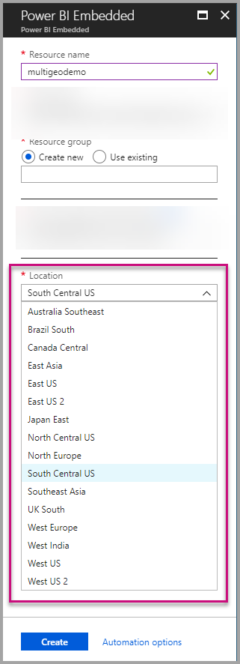
Multi-Geo support for Power BI Embedded
Multi-Geo support for Power BI Embedded (Preview) means that ISVs and organizations that build applications using Power BI Embedded to embed analytics into their apps can now deploy their data in different regions around the world.
Now customers using Power BI Embedded can set up an A capacity using Multi-Geo options, based on the same features and limitations that Power BI Premium supports using Multi-Geo.

Slide 7
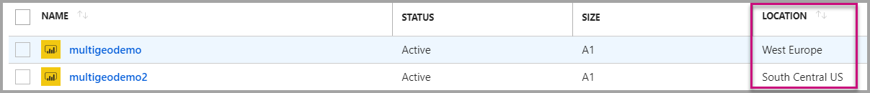
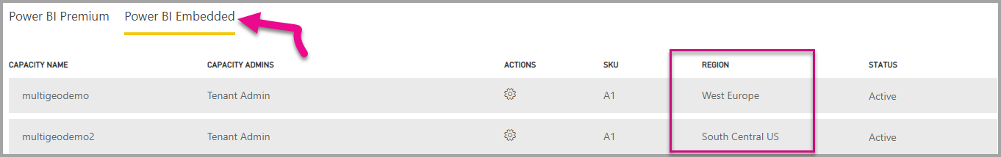
View Capacity location
You can see your capacities location easily when going to the main Power BI Embedded management page in the Azure portal.
It’s also available in the Admin Portal in Powerbi.com. In the Admin portal, choose ‘Capacity settings,’ and then switch to ‘Power BI Embedded’ tab.
Learn more about creating capacities with Power BI Embedded.

Slide 8
Manage existing capacities location
You can't change a Power BI Embedded resource location once you've created a new capacity.
To move your Power BI content to a different region, follow these steps:
Create a new capacity in a different region.
Assign all workspaces from the existing capacity to the new capacity.
Delete or pause the old capacity.
It’s important to note that if you decide to delete a capacity without reassigning its content, all the content in that capacity moves to a shared capacity, which is in your home region.

Slide 9
API support for Multi-Geo
To support management of capacities with Multi-Geo through API, we have made some changes to existing APIs:
Get Capacities - The API returns a list of capacities with access to the user. The response now includes an additional property called ‘region,’ that specifies the capacity’s location.
Assign To Capacity - The API allows assigning a given workspace to a capacity. This operation doesn't allow you to assign workspaces to a capacity outside of your home region or move workspaces between capacities in different regions. To perform this operation, the user or service principal still needs admin permissions on the workspace, and admin or assign permissions on the target capacity.
Azure Resource Manager API - all of the Azure Resource Manager API operations, including Create and Delete, supports Multi-Geo.

Slide 10
Limitations and considerations
Confirm that any movement you initiate between regions follows all corporate and government compliance requirements before initiating data transfer.
A cached query stored in a remote region stays in that region at rest. However, other data in transit may go back and forth between different geographies.
When moving data from one region to another in a Multi-Geo environment, the source data may stay in the region from which the data was moved for up to 30 days. During that time, users don't have access to it. It's removed from this region and destroyed during the 30-day period.
Multi-Geo doesn't result in better performance in general. Loading reports and dashboards still involve requests to the home region for metadata.

Slide 11
Wrap Up

